Slide 1
Introduction to Databases
Checkpoint

Slide 2

Data Structure and Schema:
SQL: Prioritizes organization and consistency. Uses a fixed schema with predefined tables and columns.
MongoDB: Allows dynamic data management. Schema-less, using flexible JSON-like documents.

Slide 3
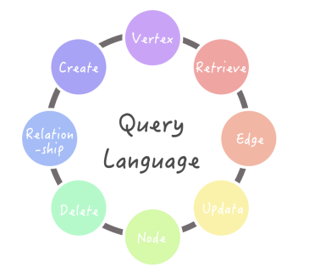
Query Language and Operations:
2.Query Language and Operations:
SQL: Utilizes SQL (Structured Query Language) for querying and manipulation.
MongoDB: Employs a rich query language for document-based queries.

Slide 4
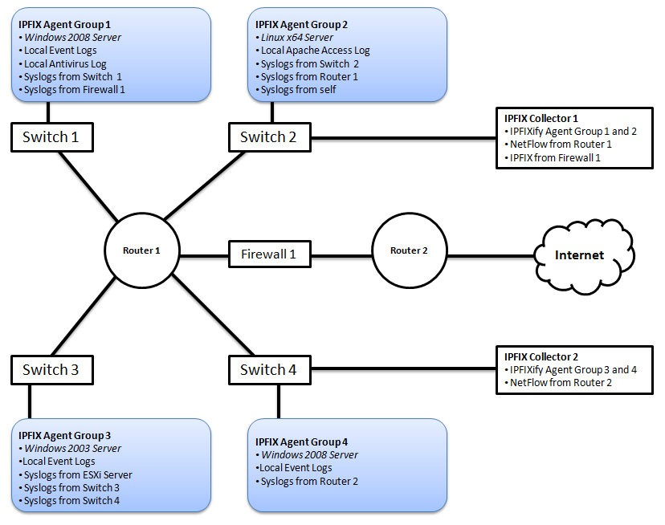
Scalability
Scalability:
SQL: Primarily oriented towards vertical scaling (adding more resources to a single server).
MongoDB: Ideal for horizontal scaling (distributing data across multiple servers).

Slide 5
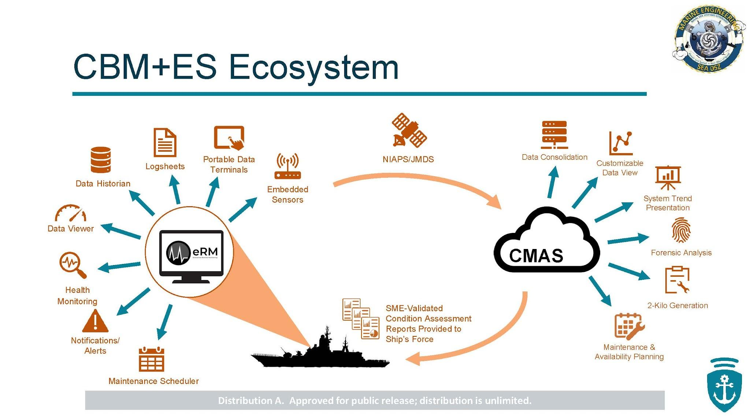
Transactions and integrity
Transactions and Data Integrity:
SQL: Ensures strong transaction capability and data integrity.
MongoDB: Sacrifices some transactional features for a more dynamic experience.
Use Cases:
SQL: Well-suited for applications requiring strict data consistency (e.g., financial systems).
MongoDB: Great for scenarios where flexibility and scalability are critical (e.g., real-time analytics).

Slide 6
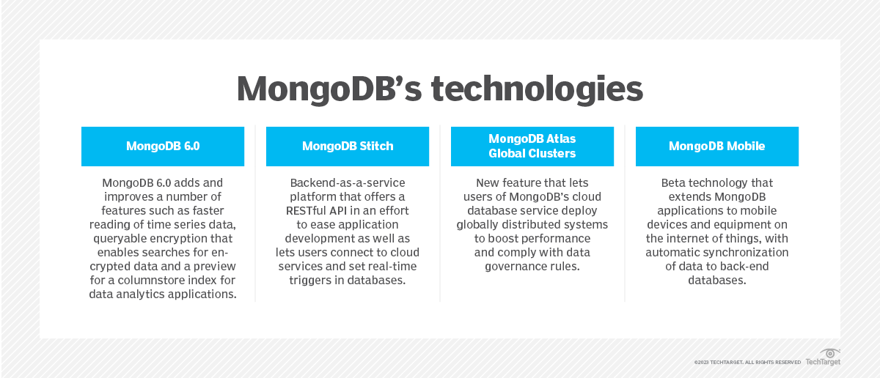
Present each type and their functionalities.
MongoDB:
Document-Oriented: MongoDB stores data in flexible, JSON-like documents (BSON format).
Schema-less: No fixed schema; fields can vary across documents.
Queries: Supports rich queries using a query language similar to JavaScript.
Scalability: Horizontally scalable, ideal for large datasets and distributed systems.
Use Cases: Well-suited for real-time analytics, content management, and IoT applications.
mo

Slide 7
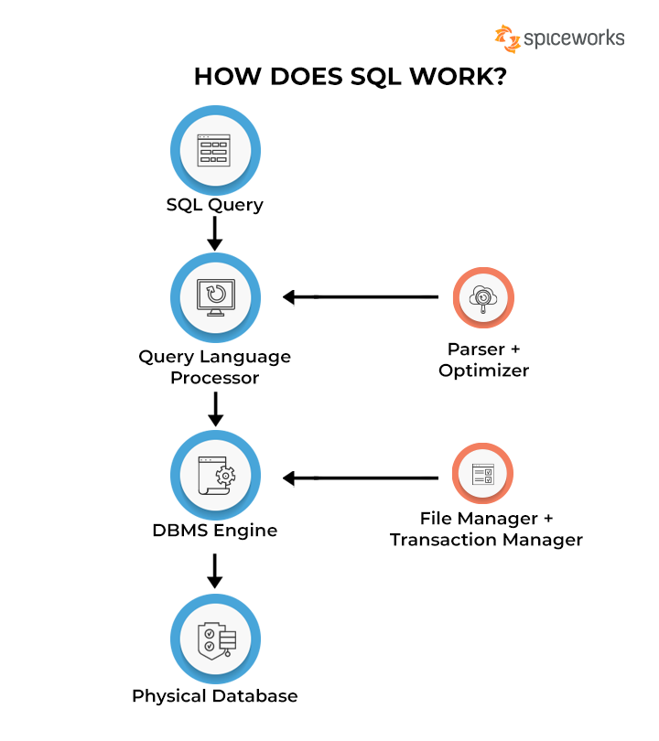
sql
SQL:
Table-Based: SQL databases use tables with predefined schemas.
Structured Query Language (SQL): Standardized language for querying and managing data.
Transactions: Ensures strong data consistency and ACID properties.
Scalability: Primarily vertical scaling (adding resources to a single server).
Use Cases: Commonly used for financial systems, e-commerce, and applications requiring strict data integrity.

Slide 8
Comparison:
Data Model:
MongoDB: Flexible, dynamic documents.
SQL: Structured tables with fixed columns.
Schema:
MongoDB: Schema-less.
SQL: Fixed schema.
Query Language:
MongoDB: JavaScript-like queries.
SQL: SQL queries.
Scalability:
MongoDB: Horizontal scaling (sharding).
SQL: Vertical scaling (adding resources to a server).
Consistency:
MongoDB: Eventual consistency.
SQL: Strong consistency.

